Slide 1

SNAKE
PASS

Slide 2
SUPRIYA SOBALE
PRATIKSHA SOLAT
SHRAVANI SAVALE
TEAM
MEMBERS

Slide 3
INTRODUCTION
The Snake game is a classic arcade game that originated in the late 1970s and gained popularity in the 1990s through early mobile phones like the Nokia 3310.
In the game, players control a snake that grows in length as it eats food, with the objective of avoiding collisions with walls or its own body.
The Snake game has been recreated and adapted for various platforms, including web browsers, mobile apps, and programming languages like Python.

Slide 4
GAME OVERVIEW
The objective of the game is to achieve the highest possible score by eating as much food as possible before colliding with a wall or the snake's own body.
Make sure the snake does not collide with the walls of the game board or its own body. Collisions will end the game.
As the snake eats more food, it grows longer, making it more challenging to navigate without colliding with obstacles.

Slide 5
ABSTRACT
This abstract describes a classic Snake game where players control the movement of a snake on a game board to eat food and grow in length.
The game offers a simple yet addictive gameplay experience that challenges players' reflexes, strategic thinking, and control skills.
The objective is to achieve the highest score by consuming as much food as possible without colliding with obstacles such as walls or the snake's own body.

Slide 6
ANALYSIS
User Interface
Clarity: Evaluate if the game interface is clear and easy to understand, including elements like the snake, food, and score display.
Aesthetics: Consider the visual design of the game, including graphics and colors, to see if they enhance the gameplay experience.
Feedback: Determine if there is sufficient feedback provided to the player, such as visual clues for successful food consumption or collisions.
The game works correctly across different operating systems and environments where Python is supported.

Slide 7
OBSERVATION
Observe if the snake moves smoothly without any jerky motion or lag. Responsive Controls: Check if the controls respond promptly to user input, allowing the player to navigate the snake effectively.
Collision Detection: Ensure that collisions with the walls or the snake's body are detected accurately and the game ends appropriately.
Scoring System: Verify that the scoring system increments correctly each time the snake eats food.

Slide 8
CONCLUSION
The Snake game, implemented using Python, offers not just entertainment but also a valuable learning experience in programming. Through this project, I've explored fundamental concepts such as data structures, user input handling, game logic, and graphics rendering.
In conclusion, the Snake game project has been both enjoyable and enlightening. It stands as a testament to my progress as a Python developer and motivates me to tackle more challenging projects in the future.

Slide 9
REFERENCE
https://www.scribd.com
https://www.robots.ox.ac.uk
https://www.slideshare.com

Slide 10
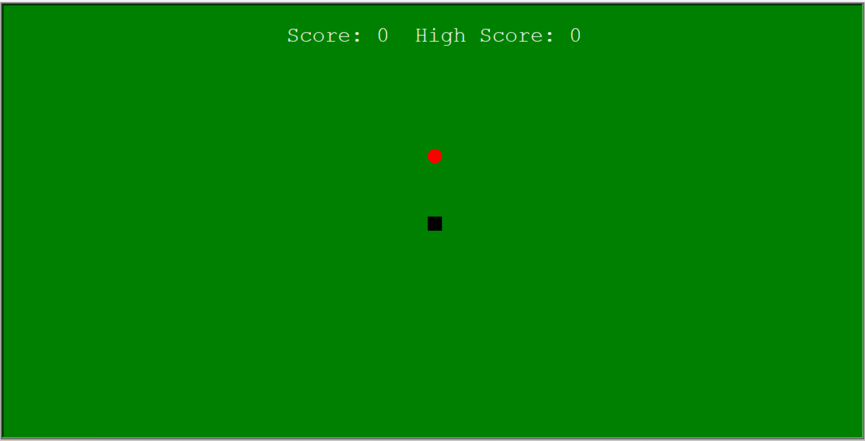
Snake GAME OUTPUT

Slide 11
Thank You !!!!!

